Slide 1
INTRODUCTION
Accurate crowd detection and tracking is vital in domains like public safety, event management, and disaster response.
Traditional systems struggle in dense scenes due to occlusion, scale variation, and limited visibility. We designed a deep learning-based pipeline integrating:
YOLOv8 with SAHI for enhanced detection
RT-DETR for transformer-based detection
DeepSORT for tracking
Person Re-Identification for multi-camera consistency Our solution achieves scalable and precise tracking in real-time conditions.

Slide 2
DATASET COLLECTION
Custom Detection Dataset
Sources: Public image repositories and local crowds
Annotation tool: MakeSenseAI
Format: YOLO and COCO-style bounding boxes
Split:
Training: 1000 images
Validation: 800 images
Testing: 500 images

Slide 3
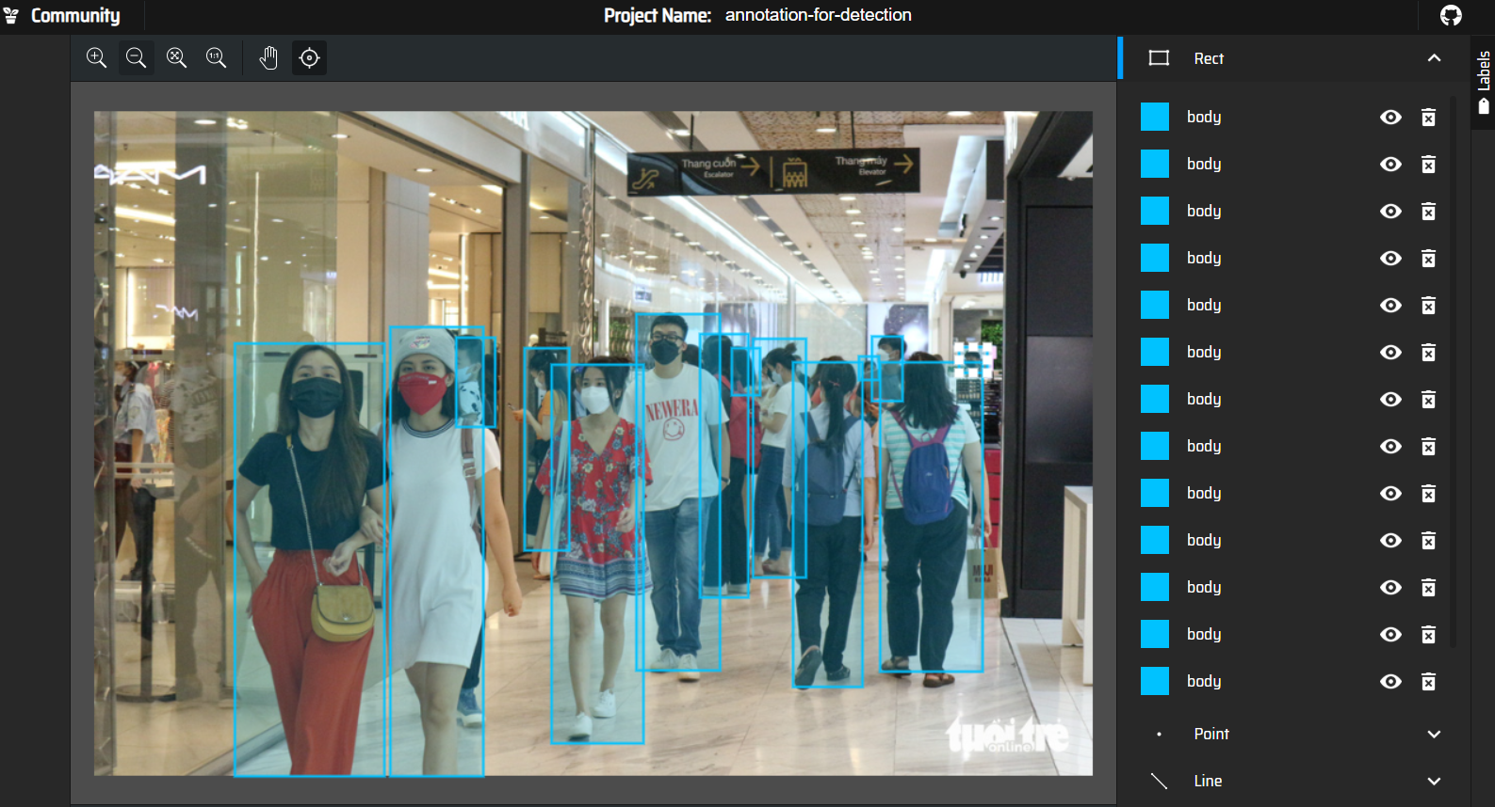
HOW WE HAVE MANUALLY ANNOTATED
Initially each of us had taken over 500+ images to manually annotate i.e draw tight bounding boxes across people in the crowd images and giving each one a label
To do this we used MakeSense.ai where the annotated images can be downloaded in a .zip package containing files in a YOLO format

Slide 4
AUGMENTATIONS
Mosaic (1.0): Combines four images into one to improve contextual diversity.
MixUp(0.4): Blends two images to enhance generalization capabilities.
Flipping: Horizontal (0.5 probability) and vertical (0.3 probability) flips to support multi-orientation detection.
HSV Augmentation: Hue, saturation, and value perturbations with hsv h=0.015, hsv s=0.7, and hsv v=0.4 to simulate diverse lighting scenarios.

Slide 5
YOLOv8 + SAHI + DeepSORT PIPELINE
YOLOv8: Real-time detection model with anchor-free design and lightweight backbone
SAHI (Sliced Aided Hyper Inference):
Slices high-resolution images into patches
Increases visibility of small or occluded people
DeepSORT:
Assigns unique IDs using motion and visual features
Ensures temporal continuity
Results: Excellent detection precision in dense crowd scenes

Slide 6
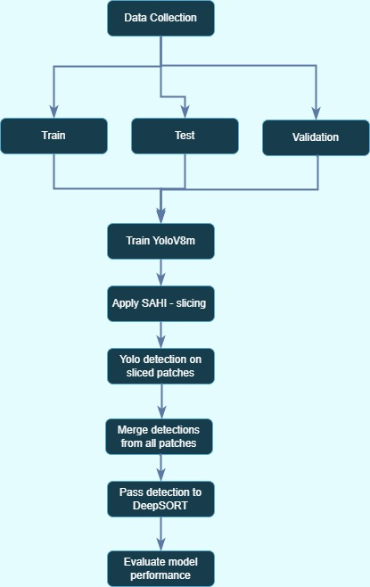

Slide 7
EXPERIMENTING WITH YOLO + SAHI + DeepSORT
Results obtained :
1. Training Loss Trends
Training losses decreased consistently: box loss (1.56 → 1.18), cls loss (1.20 → 0.82), dfl loss (1.44 → 1.19).
2. Validation Losses
Validation losses mirrored these trends: val/box loss (1.33 → 1.17), val/cls loss (0.97 →0.78), val/dfl loss (1.30 → 1.18)
3. Precision
Precision improved from 0.76 to 0.81, and recall from 0.55 to 0.61. • mAP@0.5rose from 0.67 to 0.71, while mAP@0.5:0.95 increased from 0.42 to 0.47

Slide 8
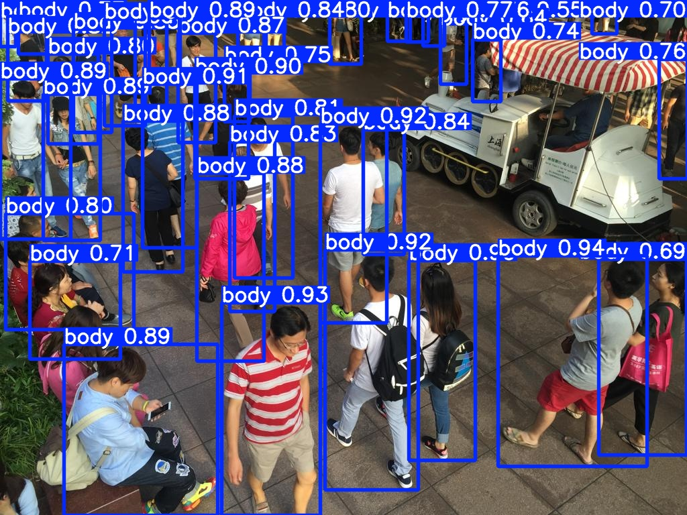
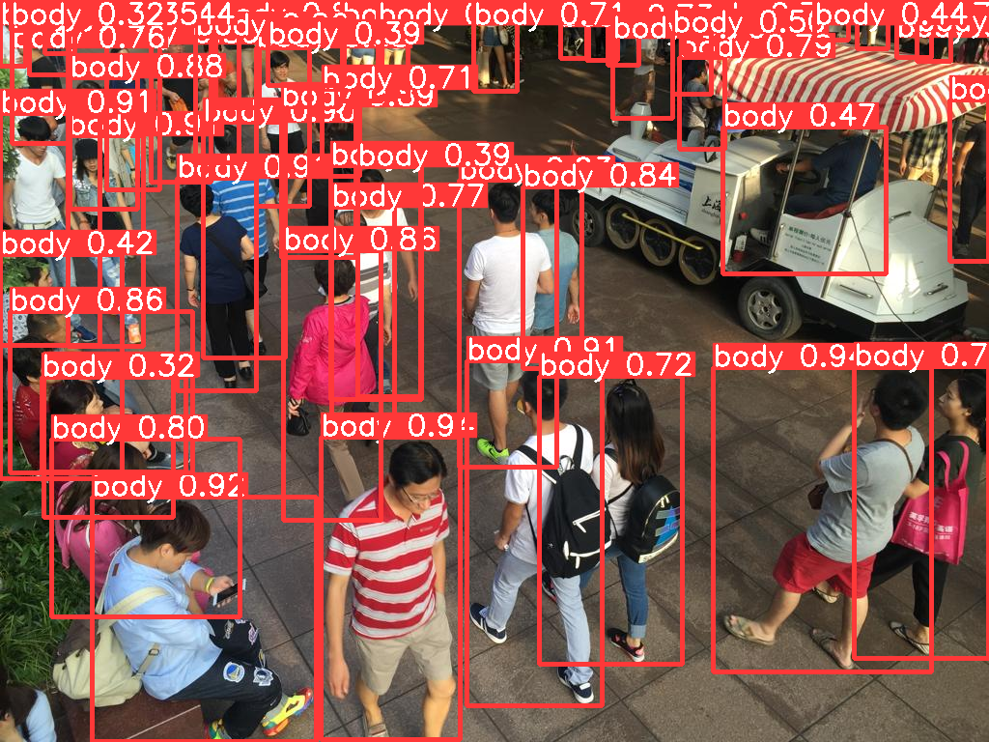
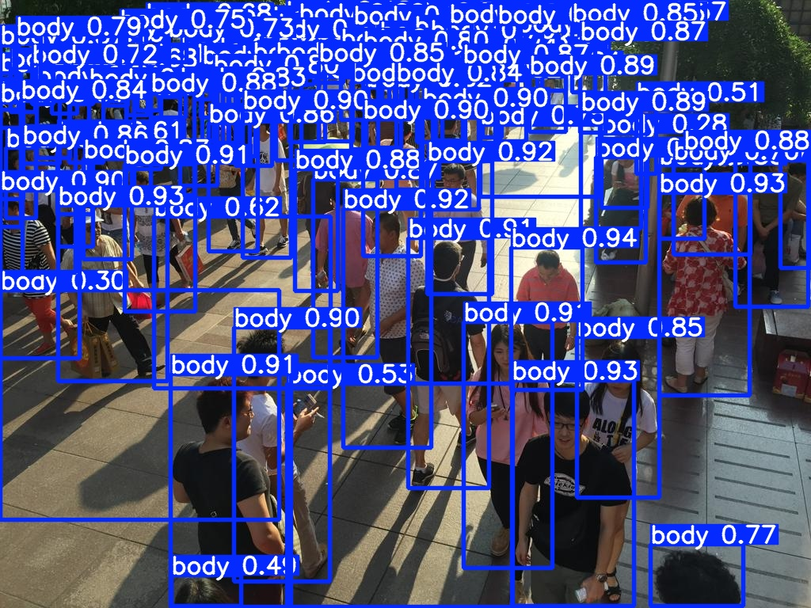
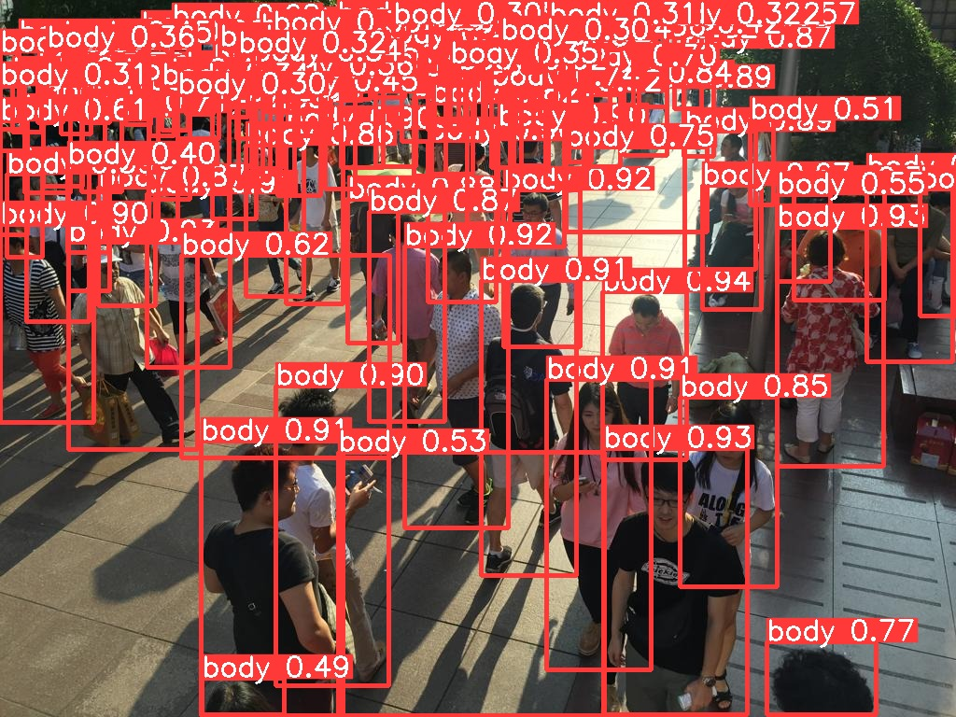
FROM YOLO:
FROM YOLO + SAHI:

Slide 9
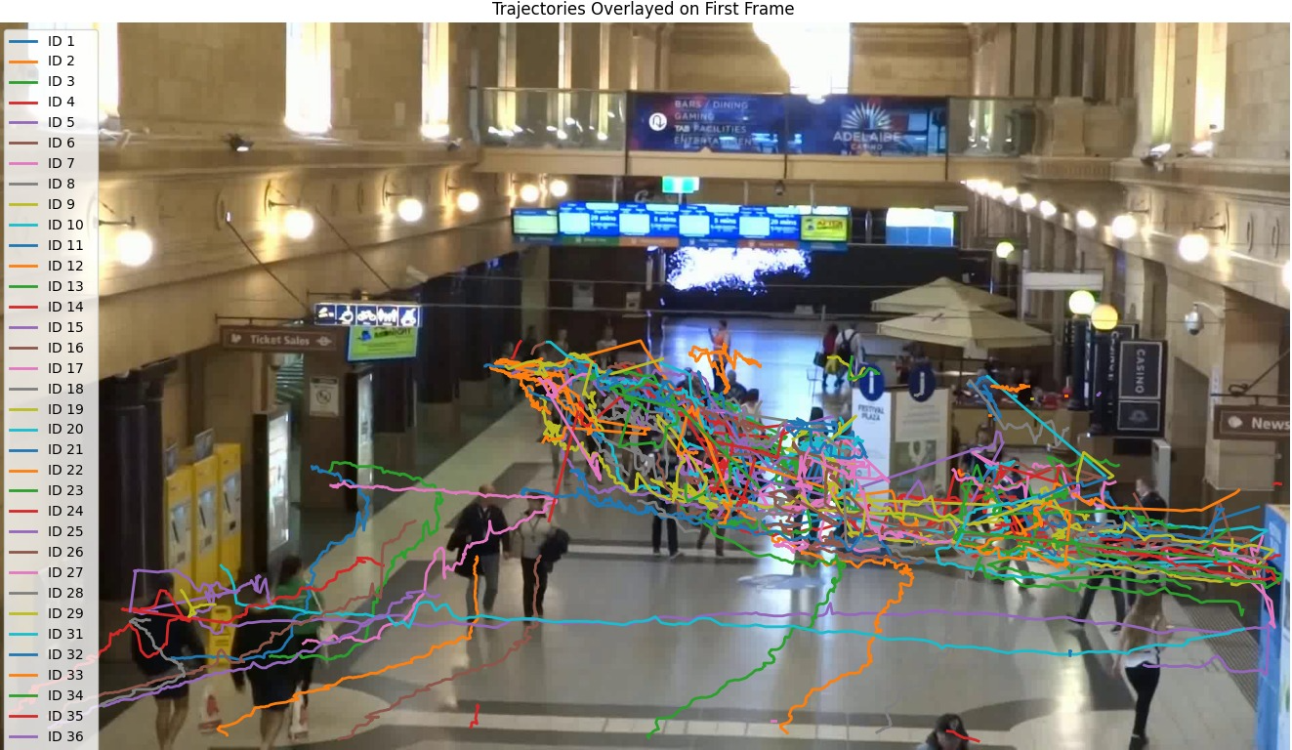
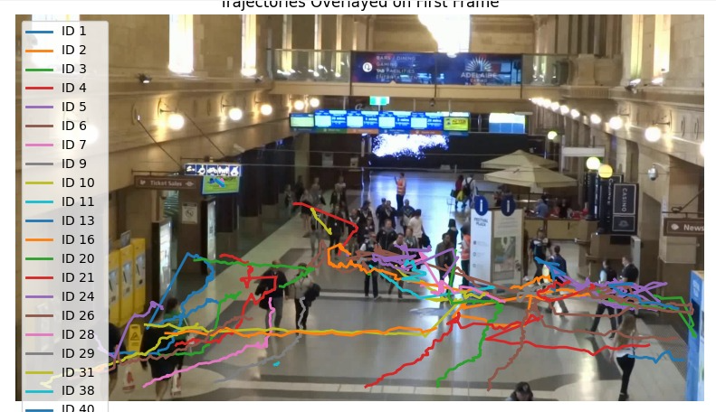
YOLO + DeepSORT TRAJECTORY RTDETR + DeepSORT TRAjectory

Slide 10
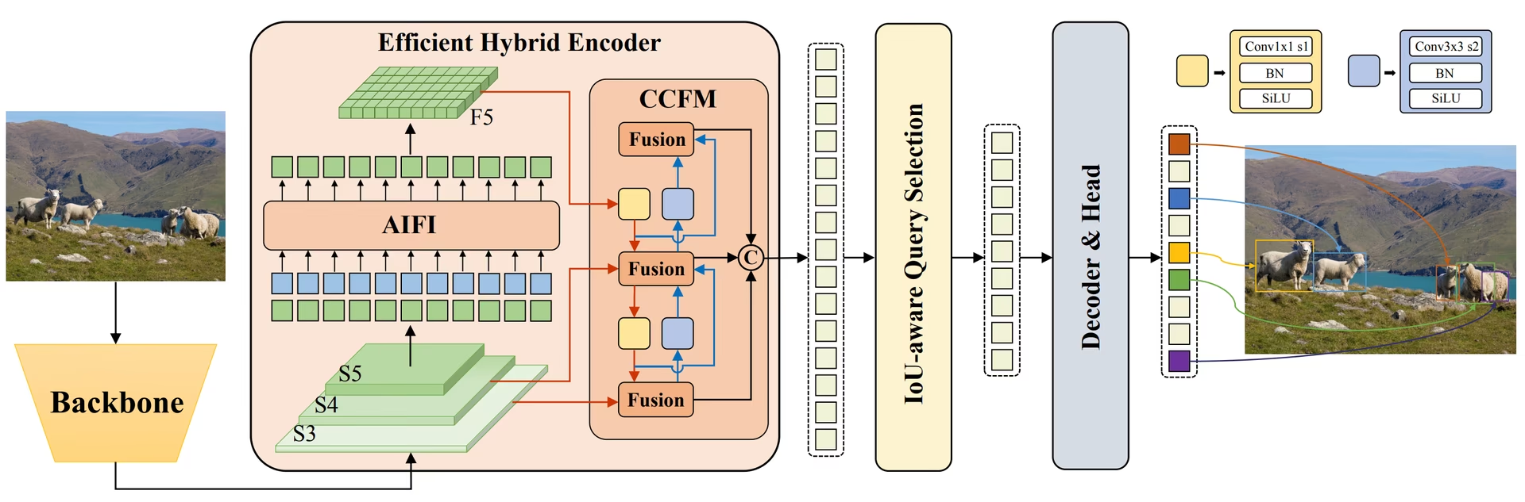
RT-DETR: ARCHITECTURE

Slide 11
EXPERIMENTING WITH RT-DETR
Results obtained from Real-Time DEtection Transformer:
1. Training Loss Trends
Classification loss consistently decreased → the model is learning to differentiate objects better over time.
L1 losses fluctuated, indicating that the model's localization (bounding box accuracy) is not very accurate..
2. Validation Losses
GIoU loss has reduced with epochs.
3. Precision
Precision remained stable (~70%), meaning the model avoids false positives reasonably well.

Slide 12
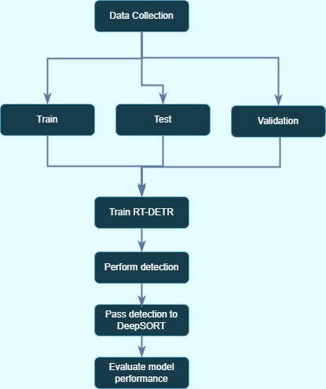

Slide 13
TRAINING PARAMETERS USED:
Platform used = google colab
Epochs = 50
Parameters = {
Image size = 640/800
Batch size = 8/16
Mixup = 0.25 (to improve recall and precision)
Patience = 10
Learning Rate = 0.0001}

Slide 14
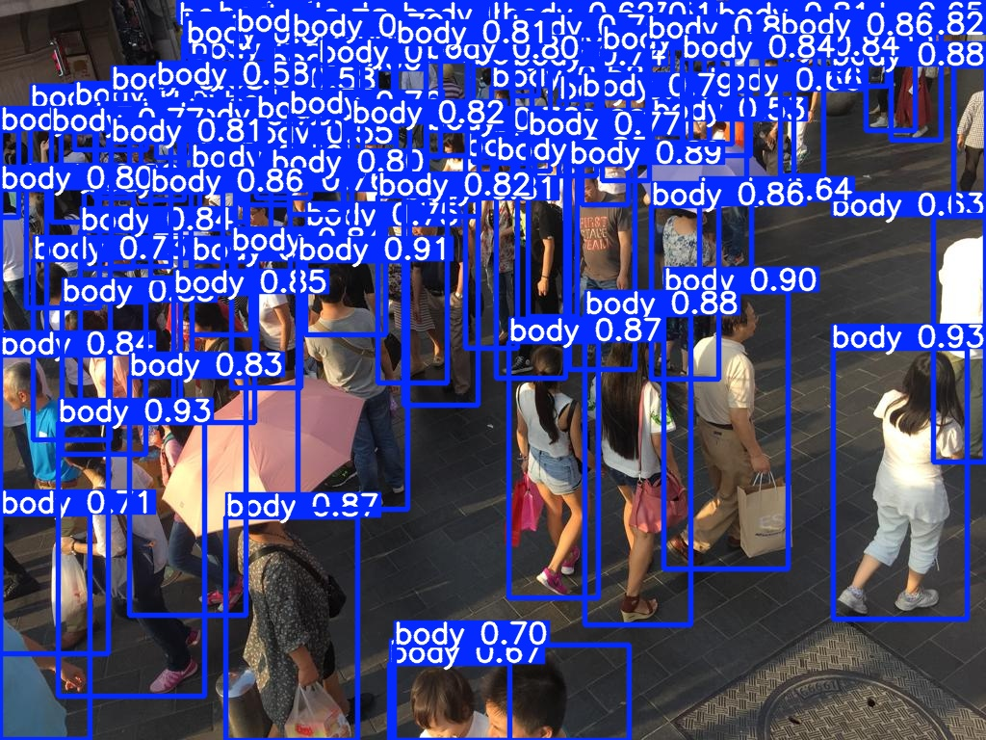
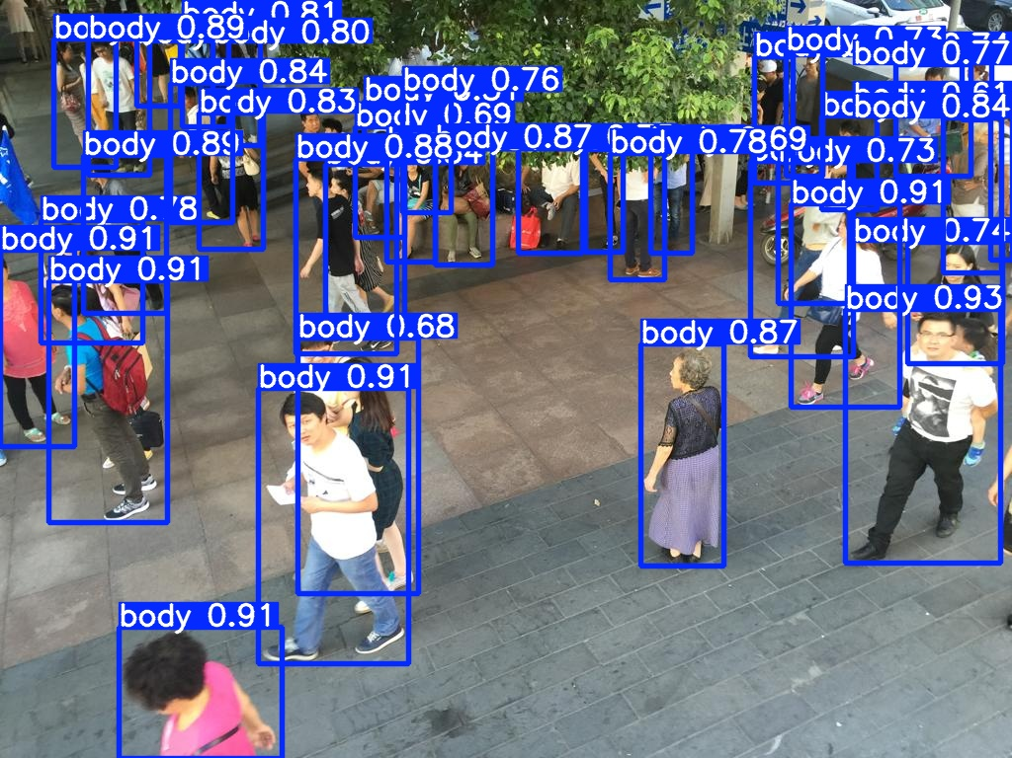
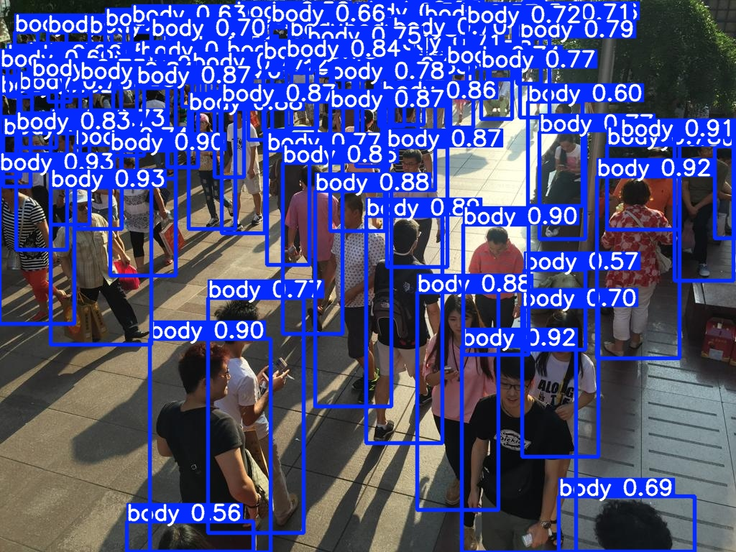
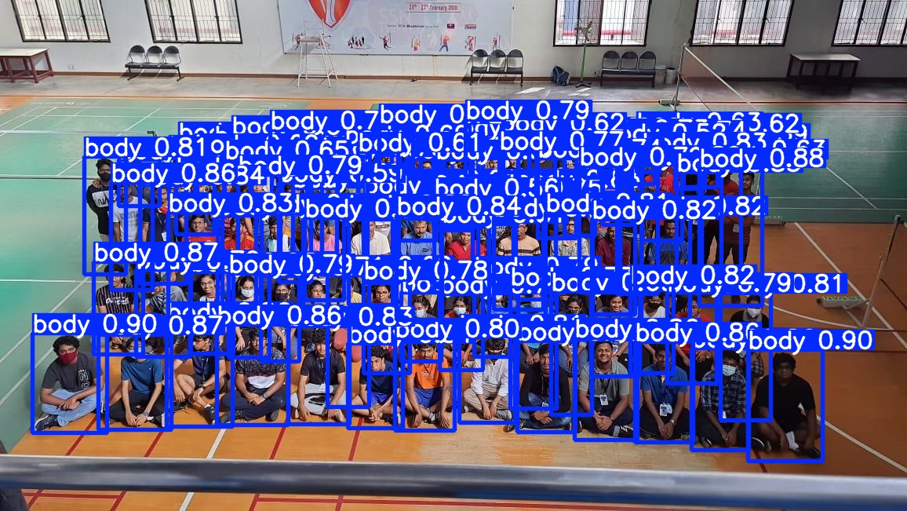
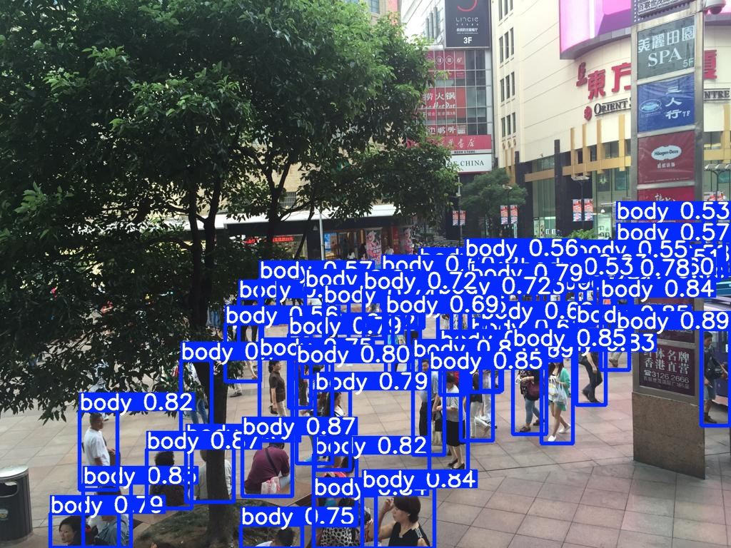
FROM RT-DETR:

Slide 15
EVALUATION METRICS
Detection Metrics:
Precision, Recall, F1 Score
mAP@0.5 (IoU threshold 0.5)
mAP@0.5:0.95 (average across thresholds)
Tracking Metrics:
IDF1: Identity assignment accuracy
MOTA: Multi-object tracking accuracy
MT / ML: Mostly Tracked vs. Mostly Lost ratios
Used to assess both short-term and long-term tracking performance

Slide 16
YOLOv8 + SAHI + DeepSORT RESULTS
Detection
Precision: 0.81 | Recall: 0.61
mAP@0.5: 0.71 | mAP@0.5:0.95: 0.47
Tracking
IDF1: 75.3% | MOTA: 68.1%
Observations
SAHI slicing greatly improved small-object detection
DeepSORT preserved identities across frames with minimal switches

Slide 17
RT-DETR + DeepSORT RESULTS
Detection
Precision: 0.78 | Recall: 0.56
mAP@0.5: 0.65 | mAP@0.5:0.95: 0.39
Tracking
IDF1: 70.6% | MOTA: 64.4%
Observations
Better boundary boxes in complex scenes
Lower overall tracking performance compared to YOLOv8 pipeline

